Slide 1
Chapter 3 Search Techniques

Slide 2
Overview
3.1 Uninformed Search Techniques
Depth first search
Breadth first search
Depth limit search
Search strategy comparison
3.2 Informed Search Techniques
Hill Climbing Search
Best First Search
Greedy Search
A* search
Adversarial search techniques – minimax and alpha beta techniques

Slide 3
Searching
Search is a universal problem-solving technique.
Searching is the process of finding the required states or nodes.
Searching is to be performed through the state space.
Search process is carried out by constructing a search tree.

Slide 4
SEARCH TERMINOLOGY
Problem Space: Environment in which the search takes place.
Problem Instance: It is Initial state + Goal state
Problem Space Graph: Graph that represents problem state. States are shown by nodes and operators are shown by edges.
Depth of a problem: Length of a shortest path or shortest sequence of operators from Initial State to goal state.
Space Complexity: The maximum number of nodes that are stored in memory.
Time Complexity: The maximum number of nodes that are created.
Admissibility: A property of an algorithm to always find an optimal solution.
Branching Factor: The average number of child nodes in the problem space graph.

Slide 5
CLASSIFICATION
Uninformed Search (Blind Search/Brute force search)
The search algorithms that do not use any extra information regarding the problem. Uninformed search strategies use no information about the likely “direction” of the goal node(s).
Depth First Search
Breath First Search
Depth Limit Search
Informed search or Heuristic search
Informed search have problem specific knowledge apart from problem definition. Informed search strategies use information about the domain to (try to) (usually) head in the general direction of the goal node(s).
Hill climbing Search
Best first Search
Greedy Search
A* Search
Adversarial Search Techniques

Slide 6
Uninformed Search Methods

Slide 7
3.1 Uninformed search strategies
Uninformed: While searching you have no clue whether one non-goal state is better than any other. Your search is blind. You don’t know if your current exploration is likely to be fruitful.
We call search algorithms that do not use any extra information regarding the problem or our representation of the problem, “blind”.
These searches typically visit all of the nodes of a tree in a certain order looking for a prespecified goal.
No cleverness is used to decide where to look next.
Searches may never find the goal state.

Slide 8
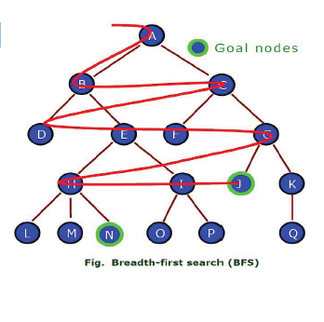
Breadth-First Search (BFS)
Proceeds level by level down the search tree.
Starting from the root node (initial state) explores all children of the root node, left to right.
If no solution is found, expands the first (leftmost)
child of the root node, then expands the
second node and so on.

Slide 9
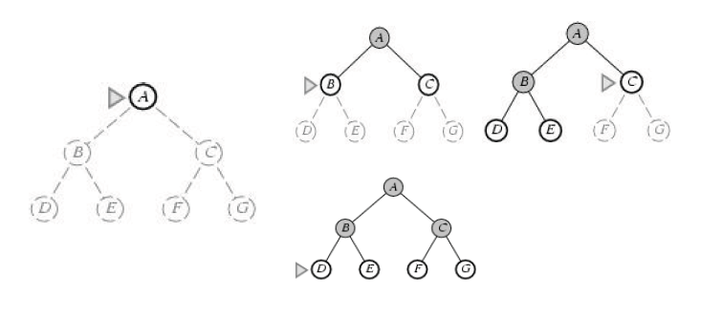
BFS example (Find path from A to D)

Slide 10
Breadth-First Search (BFS)
Completeness: Complete if the goal node is at finite depth.
Optimality: It is guaranteed to find the shortest path.
Space Complexity: (b + b² + b³ + ……………….. + b^{d} + (b^{d+1} -b) = O(b^{d+1})
Time Complexity: O(b^{d+1})

Slide 11
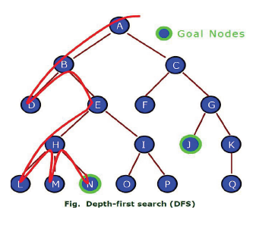
Depth First Search
Proceeds down a single branch of the tree at a time.
Expands the root node, then the leftmost child of the root node.
Always expands a node at the deepest level of the tree.
Only when the search hits a dead end
(a partial solution which can’t be extended),
the search backtrack and expand nodes at higher
levels.

Slide 12
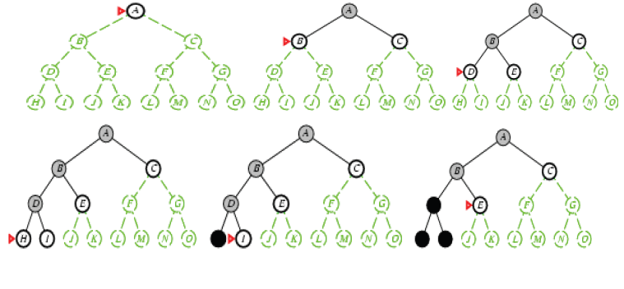
DFS example (find path from A to E)

Slide 13
DEPTH FIRST SEARCH (DFS)
Completeness: Incomplete as it may get stuck going down an infinite branch that doesn’t leads to solution.
Optimality: The first solution found by the DFS may not be shortest.
Space complexity: b as branching factor and maximum depth m, Space complexity = O(bm)
Time Complexity: O(b^{m})

Slide 14
Uniform-Cost Search
Uniform-cost is guided by path cost rather than path length like in BFS, the algorithms starts by expanding the root, then expanding the node with the lowest cost from the root, the search continues in this manner for all nodes.
If all step costs are equal, this is identical to breadth-first search.
Uniform-cost search does not care about the number of steps a path has, but only about their cost. Therefore, algorithm expands nodes in order of increasing path cost.

Slide 15
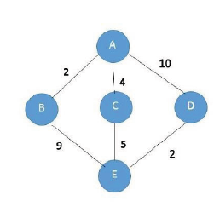
UCS example (Find path from A to E)
Expand A to B, C, and D.
The path to B is the cheapest one with path cost 2.
Expand B to E
Total path cost = 2+9 =11
This might not be the optimal solution since the path
AC as path cost 4 (less than 11)
Expand C to E
Total path cost = 4+5 =9
Path cost from A to D is 10 (greater than path cost, 9)
Hence optimal path is ACE.

Slide 16
Uniform-Cost Search
Completeness: Complete if the cost of each step exceeds some small positive integer, this to prevent infinite loops.
Optimality: Optimal in the sense that the node that it always expands is the node with the least path cost.
Space Complexity: Uniform cost search is guided by path cost rather than depth, so its complexity cannot be characterized in terms of b and d. Instead, let c be the cost of optimal solution and every action to reach solution costs at least e, then in worst case space complexity = O(b^{C/e})
Time Complexity: O(b^{C/e})

Slide 17
Depth Limit Search
Depth-first search will not find a goal if it searches down a path that has infinite length. So, in general, depth-first search is not guaranteed to find a solution, so it is not complete.
This problem is eliminated by limiting the depth of the search to some value L. However, this introduces another way of preventing depth-first search from finding the goal: if the goal is deeper than L it will not be found.
Perform depth first search but only to a pre-specified depth limit L.
No node on a path that is more than L steps from the initial state.

Slide 18
Depth Limit Search
Completeness: Incomplete as solution may be beyond specified depth level.
Optimality: not optimal
Space complexity: b as branching factor and L as tree depth level,
O (b.L)
Time Complexity: O(b^{L})

Slide 19
Iterative Deepening Search (IDS)
Iterative deepening search is a strategy that sidesteps the issue of choosing the best depth limit by trying all possible depth limits: first depth 0, then depth 1, then depth 2, and so on.
In effect, iterative deepening combines the benefits of depth-first and breadth-first search.
It is optimal and complete, like breadth-first search, but has only the modest memory requirements of depth-first search.

Slide 20
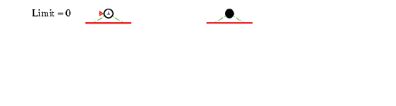
Iterative deepening search L=0

Slide 21
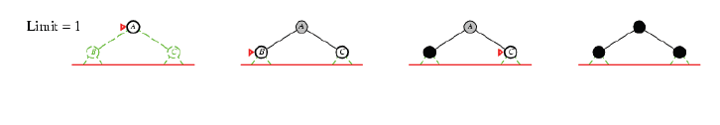
Iterative deepening search L=1

Slide 22
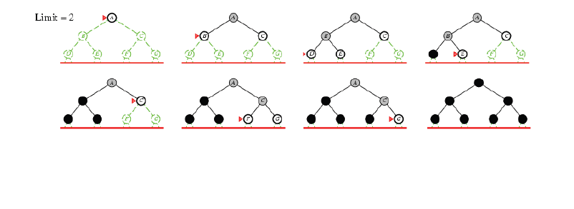
Iterative deepening search L=2

Slide 23
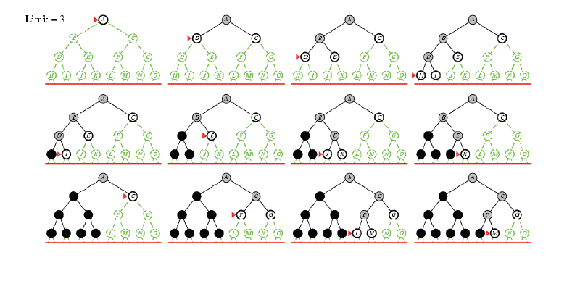
Iterative Deepening Search L=3

Slide 24
Iterative Deepening Search
Completeness: Yes, when the branching factor is finite.
Optimality: Optimal
Space complexity: b as branching factor and d as depth level,
O (b.d)
Time Complexity: O(b^{d})

Slide 25
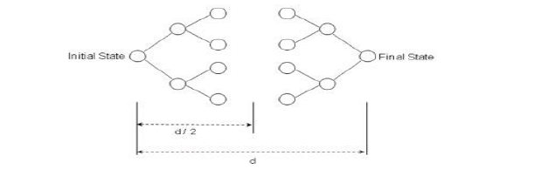
Bidirectional Search
As the name suggests, bidirectional search suggests to run 2 simultaneous searches.
One from the initial state and the other from the Final state.
Those 2 searches stop when they meet each other at some point in the middle of the graph.

Slide 26
Bidirectional Search
Completeness: Bidirectional search is complete when we use BFS in both searches
Optimality: Like the completeness, bidirectional search is optimal when BFS is used.
Time/Space Complexity : O(b^{d/2})

Slide 27
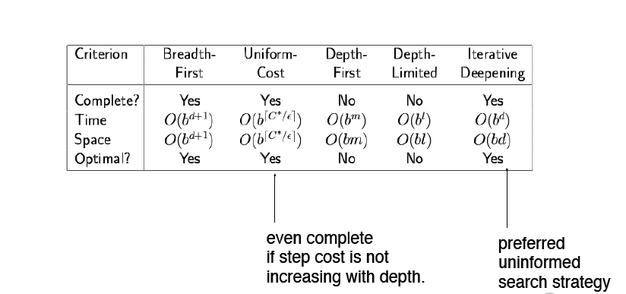
Summary of algorithms

Slide 28
Informed Search Methods

Slide 29
3.2 Informed Search (Heuristic Search)
Informed search have problem specific knowledge apart from problem definition.
They use experimental algorithm which improves efficiency of search process.
The idea is to develop a domain specific heuristic function h(n) where h(n) guesses the cost of getting to the goal from node n.
Heuristic Function = The heuristic function is a way to inform the search about the direction to a goal. It provides an informed way to guess which neighbor of a node will lead to a goal.

Slide 30
Best-First Search (BFS)
Best-First search is a heuristic search algorithm.
The name “best-first” refers to the method of exploring the node with the best “score” first.
An evaluation function is used to assign a score to each candidate node. The evaluation function must represent some estimate of the cost of the path from state to the closest goal state.

Slide 31
Best-First Search (BFS)
Algorithm
1. Put the initial node on a list START
2. If START = GOAL or START = EMPTY, then terminate search
3. Assign the next node as START and call this node-A
4. If A = GOAL, terminate the search with success
5. Else-if, node has successor and generate all of them. Find out how far they are from the GOAL node.
6. Sort all the children generated so far by remaining distance from the goal. Name the list as START-1. Replace START = START-1
7. Go to step-2

Slide 32

Best-First Search (BFS)

Slide 33
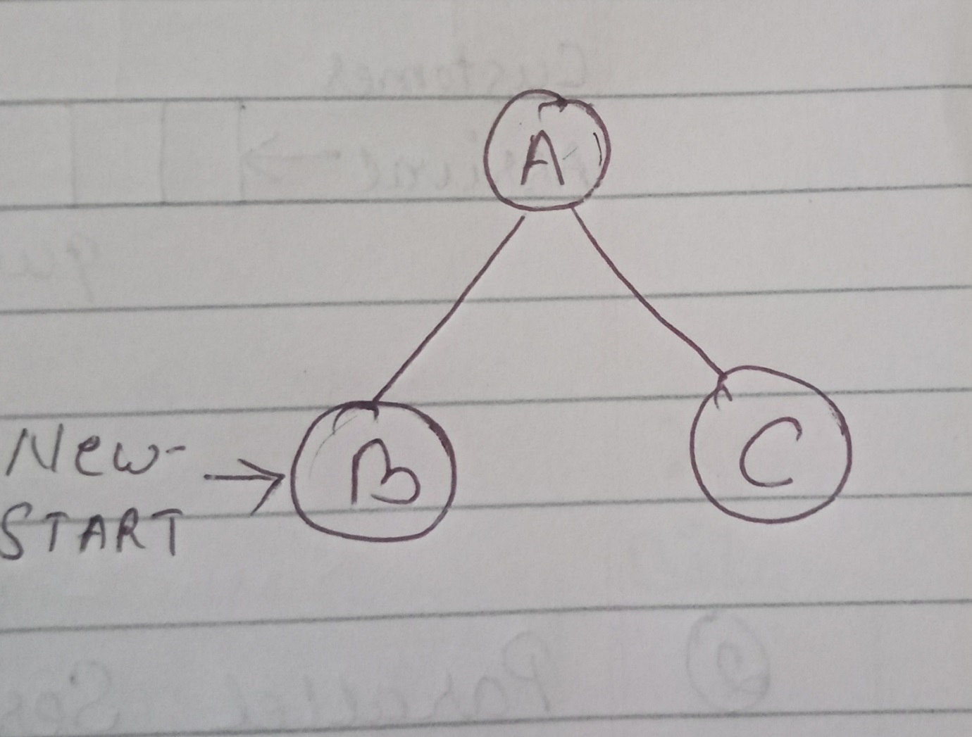
Best-First Search (BFS)

Slide 34
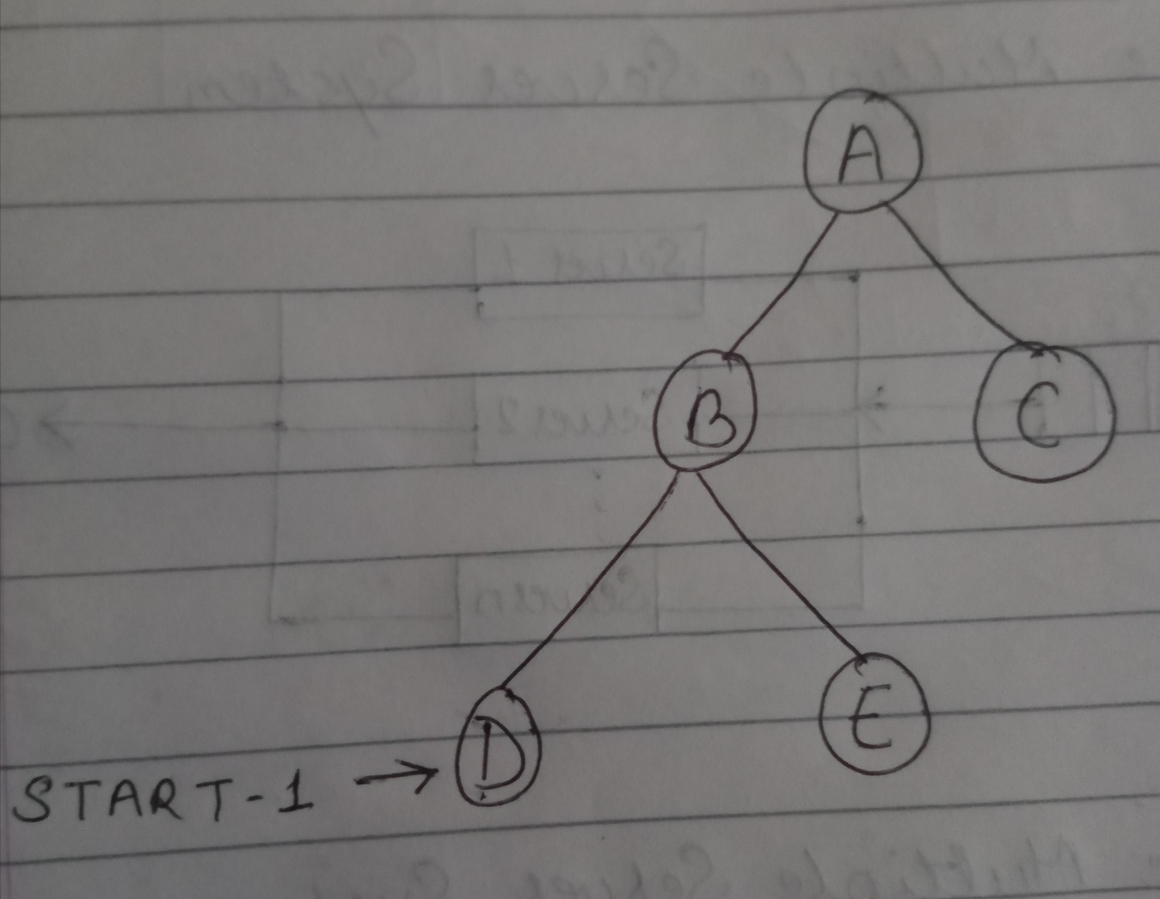
Best-First Search (BFS)

Slide 35
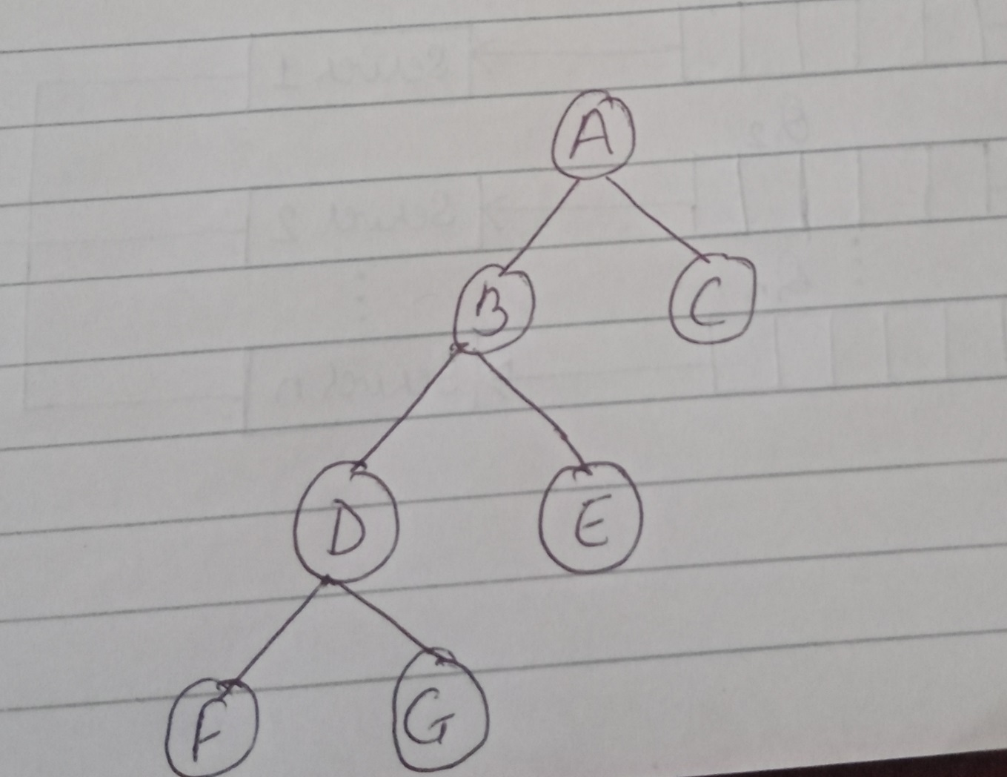
Best-First Search (BFS)

Slide 36
Types of BFS
Greedy Best First Search
A* Search

Slide 37
Greedy Best First Search
It tries to get as close as it can to the goal.
It expands the node that appears to be closest to the goal.
It evaluates the node by using heuristic function only.
Evaluation function f(n) = h(n)
heuristic= (estimate of cost from n to goal)
h(n) = 0 for goal state

Slide 38
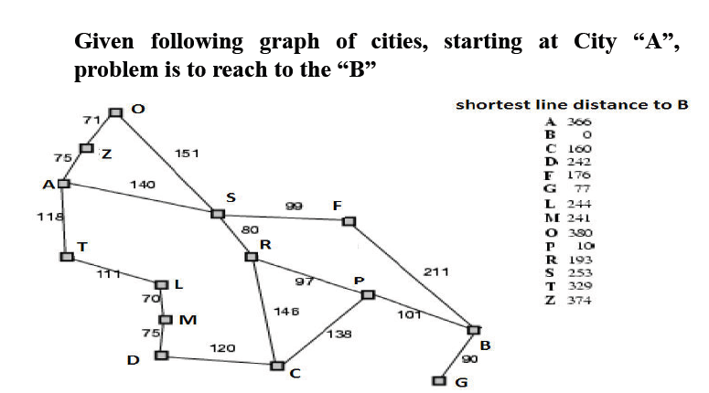
Greedy Best First Search

Slide 39
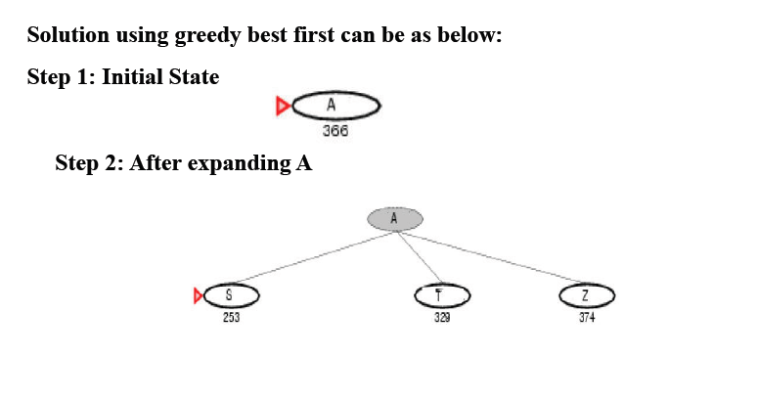
Greedy Best First Search

Slide 40
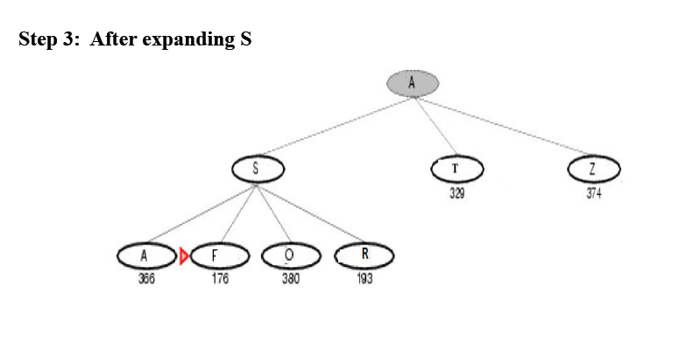
Greedy Best First Search

Slide 41
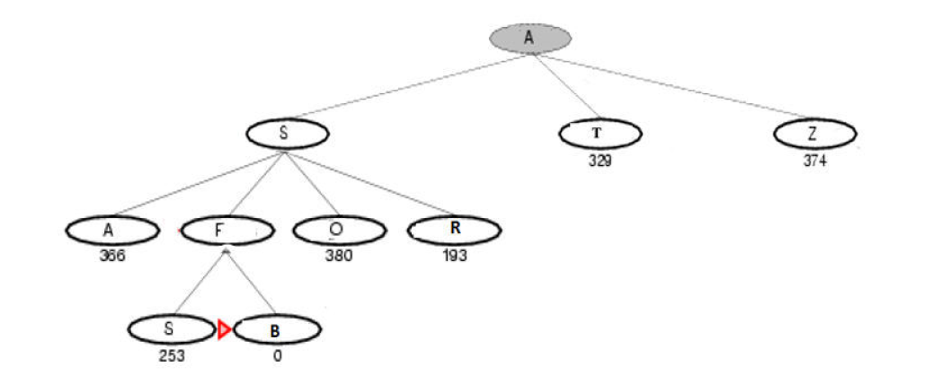
Greedy Best First Search
Step 4: After expanding F

Slide 42
Greedy Best First Search
Properties:
Completeness: No, can get stuck in loops.
Time Complexity: O(b^{m}), but a good heuristic can give dramatic improvement
Space Complexity: O(b^{m}), keeps all nodes in memory
Optimality: No
Applications:
This algorithm is used in Huffman encoding, minimum spanning tree, Dijkstra’s algorithm etc.

Slide 43
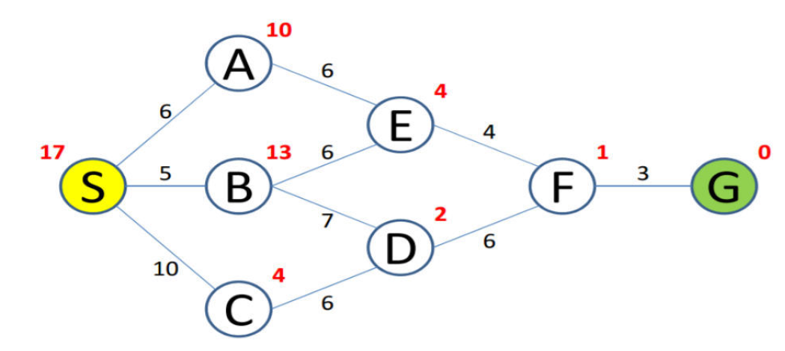
Perform Greedy Best First Search

Slide 44
A* Search
It finds a minimal cost-path joining the start node and a goal node for node n.
Evaluation function: f(n) = g(n) + h(n) Where,
g(n) = cost so far to reach n from root
h(n) = estimated cost to goal from n
Thus, f(n) estimates always the lowest total cost of any solution path going through node n.
Avoid expanding paths that are already expensive.

Slide 45
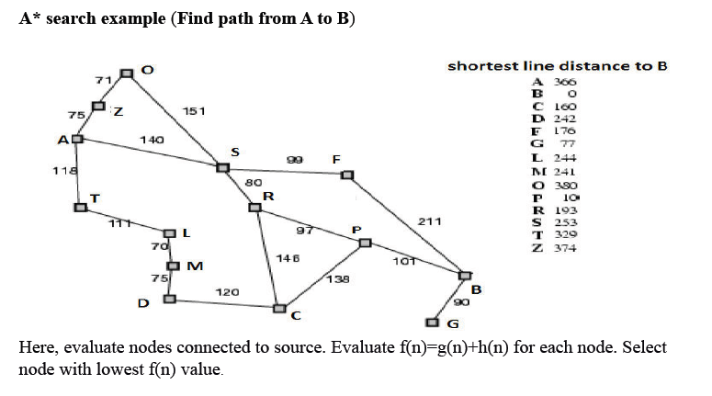
A* Search

Slide 46
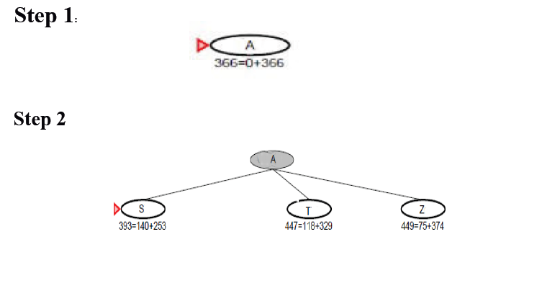
A* Search

Slide 47
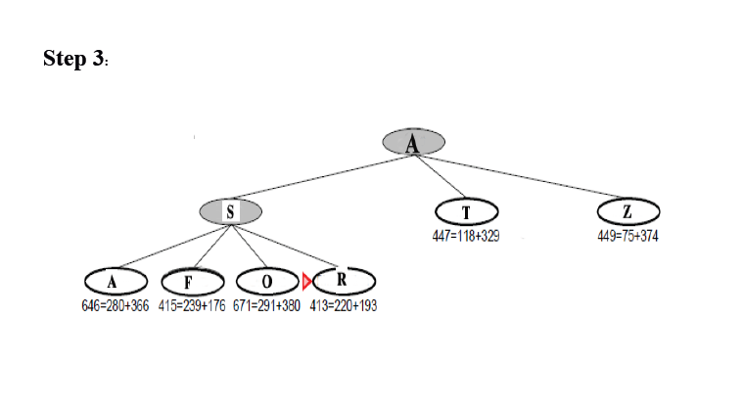
A* Search

Slide 48
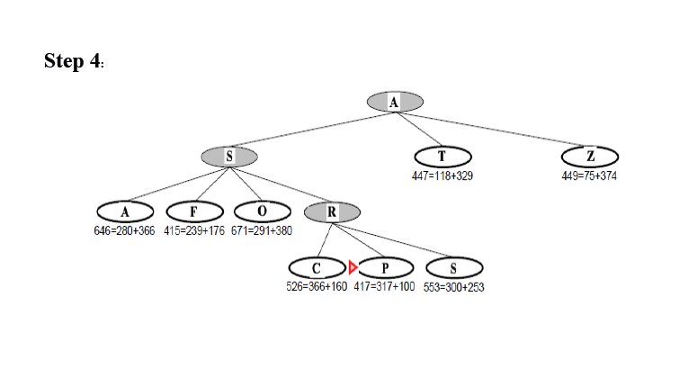
A* Search

Slide 49
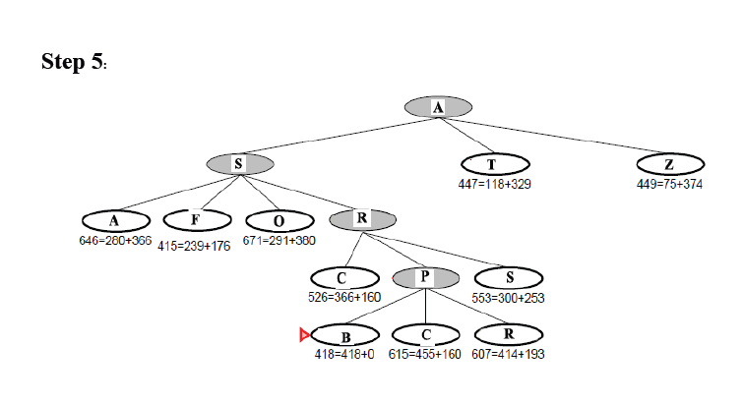
A* Search

Slide 50
Properties of A* Search
Complete ?
Yes
Optimal?
Yes
Time Complexity
Exponential in [relative error in h * length of solution]
Space
Keeps all nodes in memory, hence O(b^{d})

Slide 51
Perform A* Search

Slide 52
Hill Climbing Search (Local Search Algorithm)
Hill climbing is an extension of depth-first search which uses some knowledge such as estimates of the distance of each node from the goal to improve the Search.
It operates using a single current state and generally moves only to neighbor of current state.
It is simply a loop that continually moves in the direction of increasing value—that is, uphill. It terminates when it reaches a “peak” where no neighbor has a higher value.
Hill climbing is sometimes called greedy local search because it grabs a good neighbor state without thinking ahead about where to go next.

Slide 53
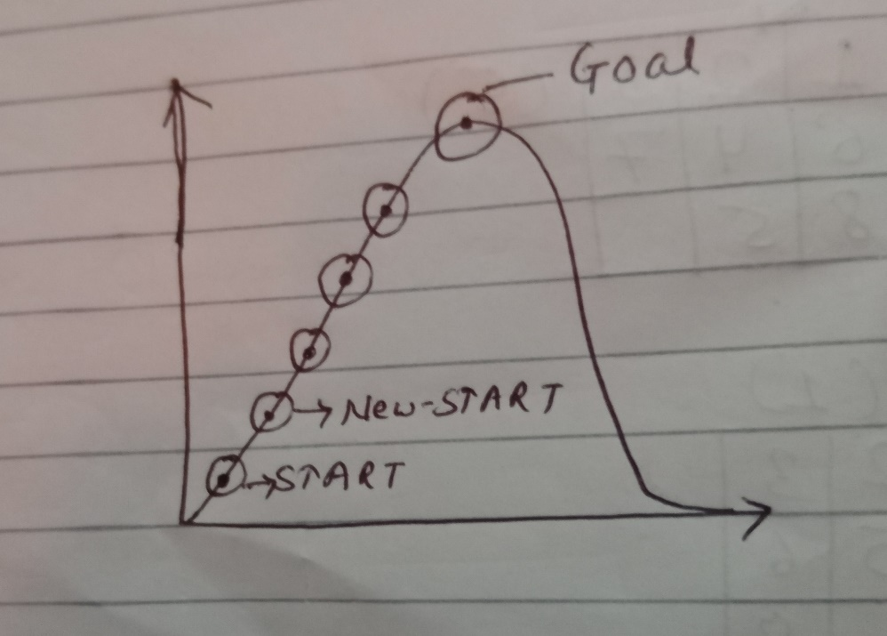
Hill Climbing Search
Algorithm
Evaluate the initial state, if it is goal state then return and quit.
Loop until a solution is found or there are no new operators (nodes) left.
Select and apply new operator.
Evaluate new state
If it is a goal state, then quit.
If it is better than current state
then make it a new current state.
III. If it is not better than current state then go to step 2.

Slide 54
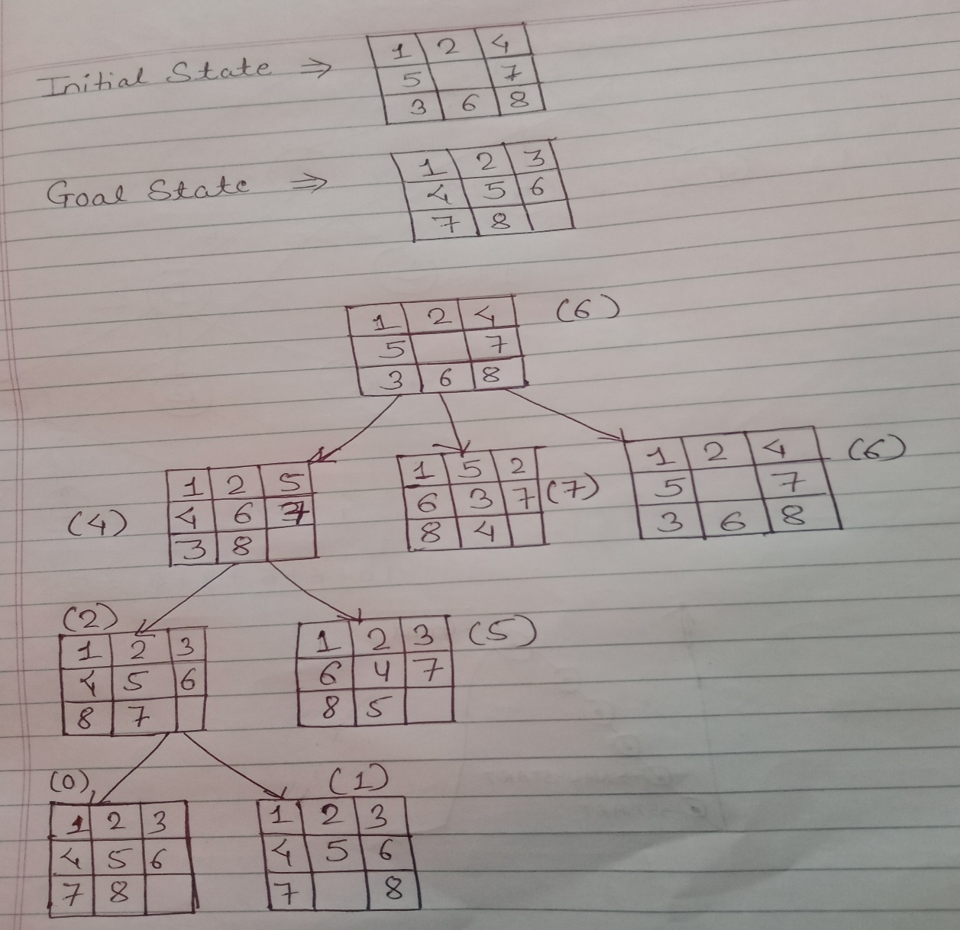
Hill Climbing Search- Example

Slide 55
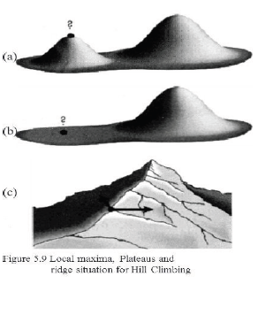
Hill Climbing Search
Drawbacks
Local Maxima
A local maximum is a peak that is higher than
each of its neighboring states but lower than the
global maximum.
Plateaus
A plateau is an area of the search space where
evaluation function is flat, thus requiring random
walk.
Ridges
Where there are steep slopes and the search direction is not towards the top but towards the side.

Slide 56
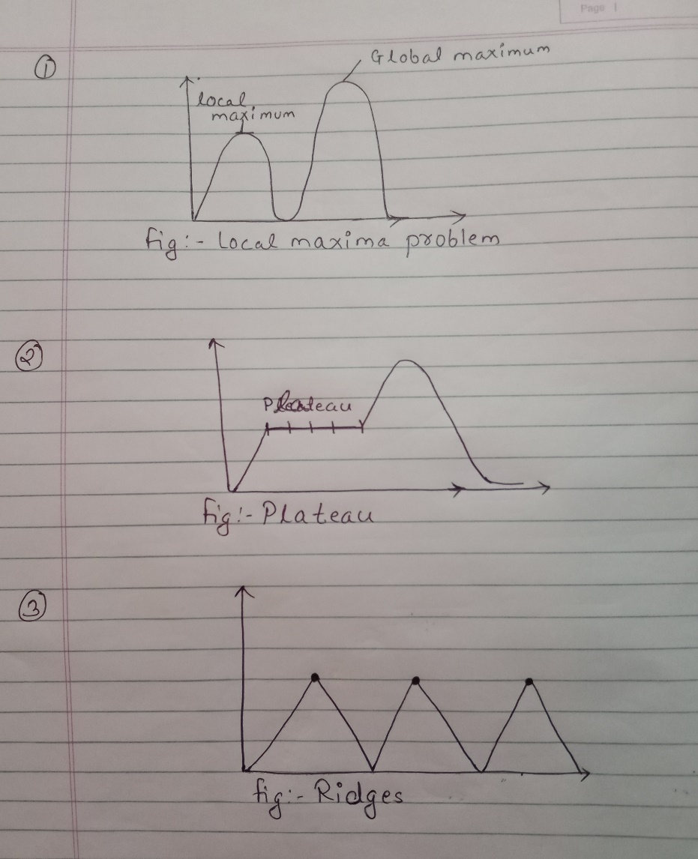
Hill Climbing Search (Drawbacks)

Slide 57
Hill Climbing Search
Remedies
Back tracking for local maximum
The back tracking help in undoing what is been done so far and permit to try totally different part to attain the global peak.
Big Jump
A big jump is the solution to escape from plateaus because all neighbors’ points have same value using the greedy approach.
Random restart
Keep restarting the search from random locations until a goal is found.

Slide 58
Why Hill Climbing is not Complete?
Hill-climbing always attempts to make changes that improve the current state.
The main problem that hill climbing can encounter is that of local maxima. This occurs when the algorithm stops making progress towards an optimal solution; mainly due to the lack of immediate improvement in adjacent states.

Slide 59
Simulated Annealing
Simulated Annealing escapes local maxima by allowing some "bad" moves but gradually decrease their frequency.
Instead of restarting from a random point, we allow the search to take some downhill steps to try to escape local maxima.

Slide 60
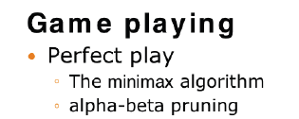
Adversarial Search
Adversarial search used in game playing is the type of search where we examine the problems that arise when we try to plan ahead in the world where others are planning against us.
A game can be formally defined as a kind of search problem as below:
Initial state: It includes the board position and identifies the player’s to move.
Successor function: It gives a list of (move, state) pairs each indicating a legal move and resulting state.
Terminal test: This determines when the game is over. States where the game is ended are called terminal states.
Utility function: It gives numerical value of terminal states. E.g. win (+1), loose (-1) and draw (0).

Slide 61
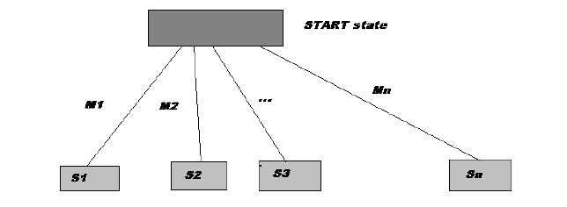
Game Trees
We can represent all possible games(of a given type) by a directed graph often called a game tree.
The nodes of the graph represent the states of the game. The arcs of the graph represent possible moves by the players (+ and -).

Slide 62
Game Playing
Example: Tic-tac-toe
There are two players denoted by X and O. They are alternatively writing their letter in one of the 9 cells of a 3 by 3 board. The winner is the one who succeeds in writing three letters in line.
The game begins with an empty board. It ends in a win for one player and a loss for the other, or possibly in a draw.
A complete tree is a representation of all the possible plays of the game.
The root node is the initial state, in which it is the first player's turn to move (the player X).
The successors of the initial state are the states the player can reach in one move, their successors are the states resulting from the other player's possible replies, and so on.

Slide 63
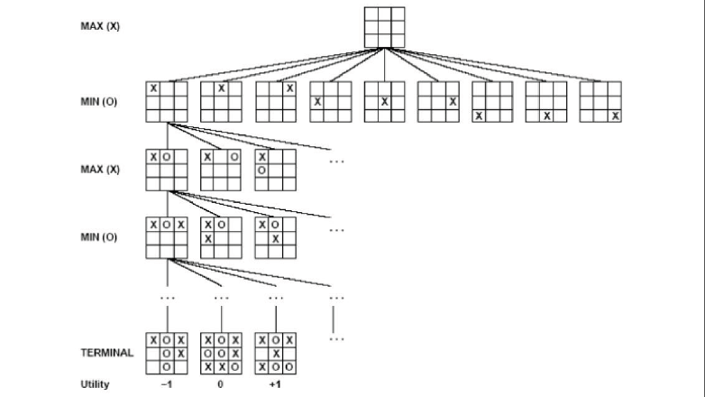

Slide 65
The Minimax Algorithm

Slide 66
The Minimax Algorithm

Slide 67
The Minimax Algorithm

Slide 68
The Minimax Algorithm

Slide 69
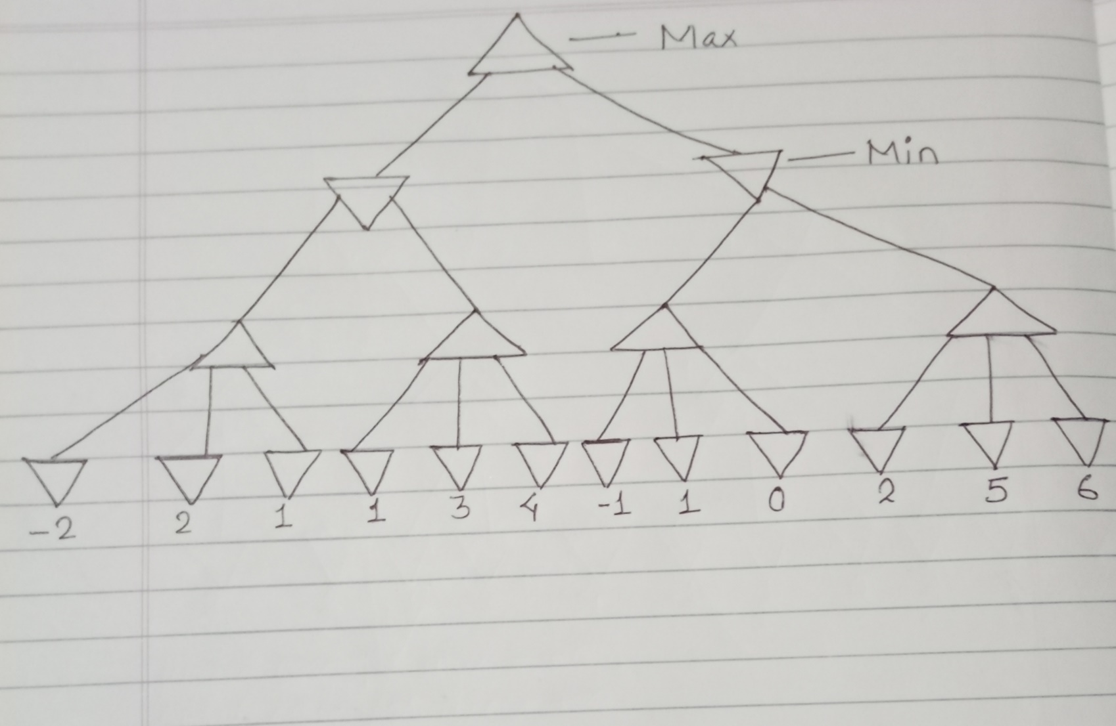
The Minimax Algorithm: Example 1

Slide 70
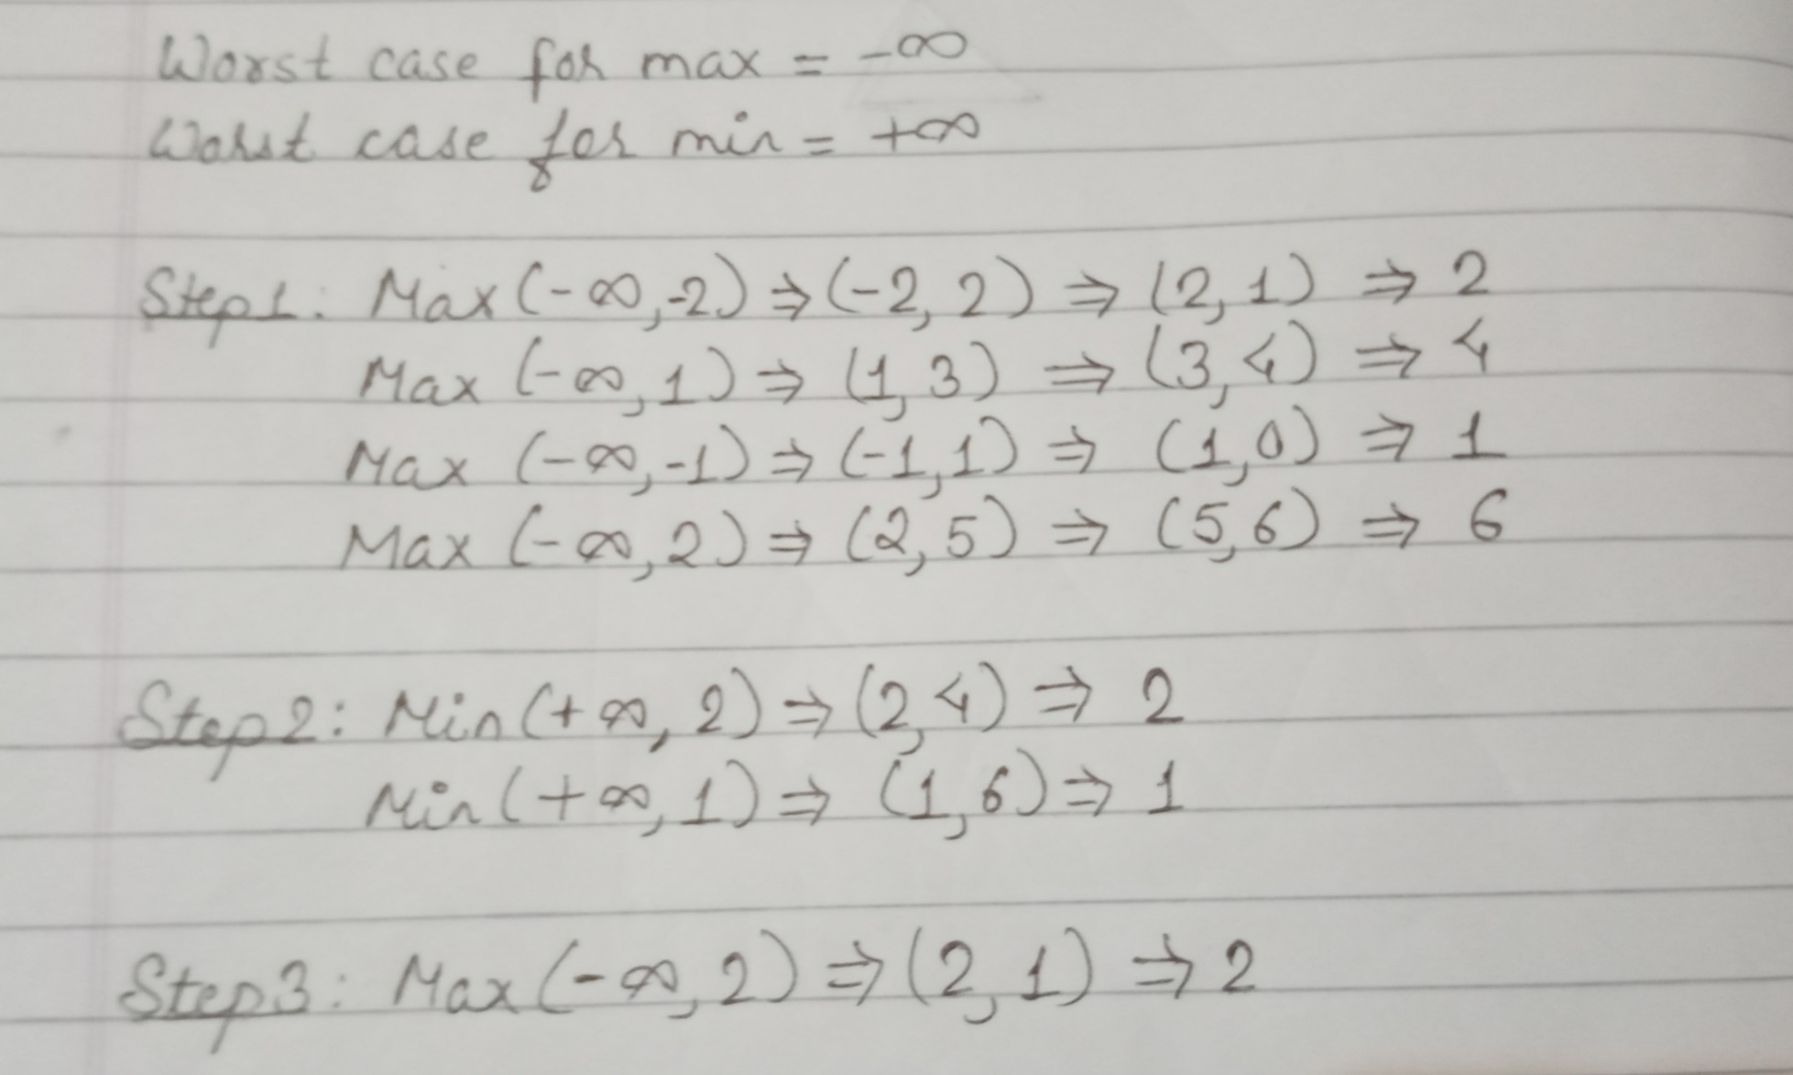
The Minimax Algorithm: Example 1

Slide 71
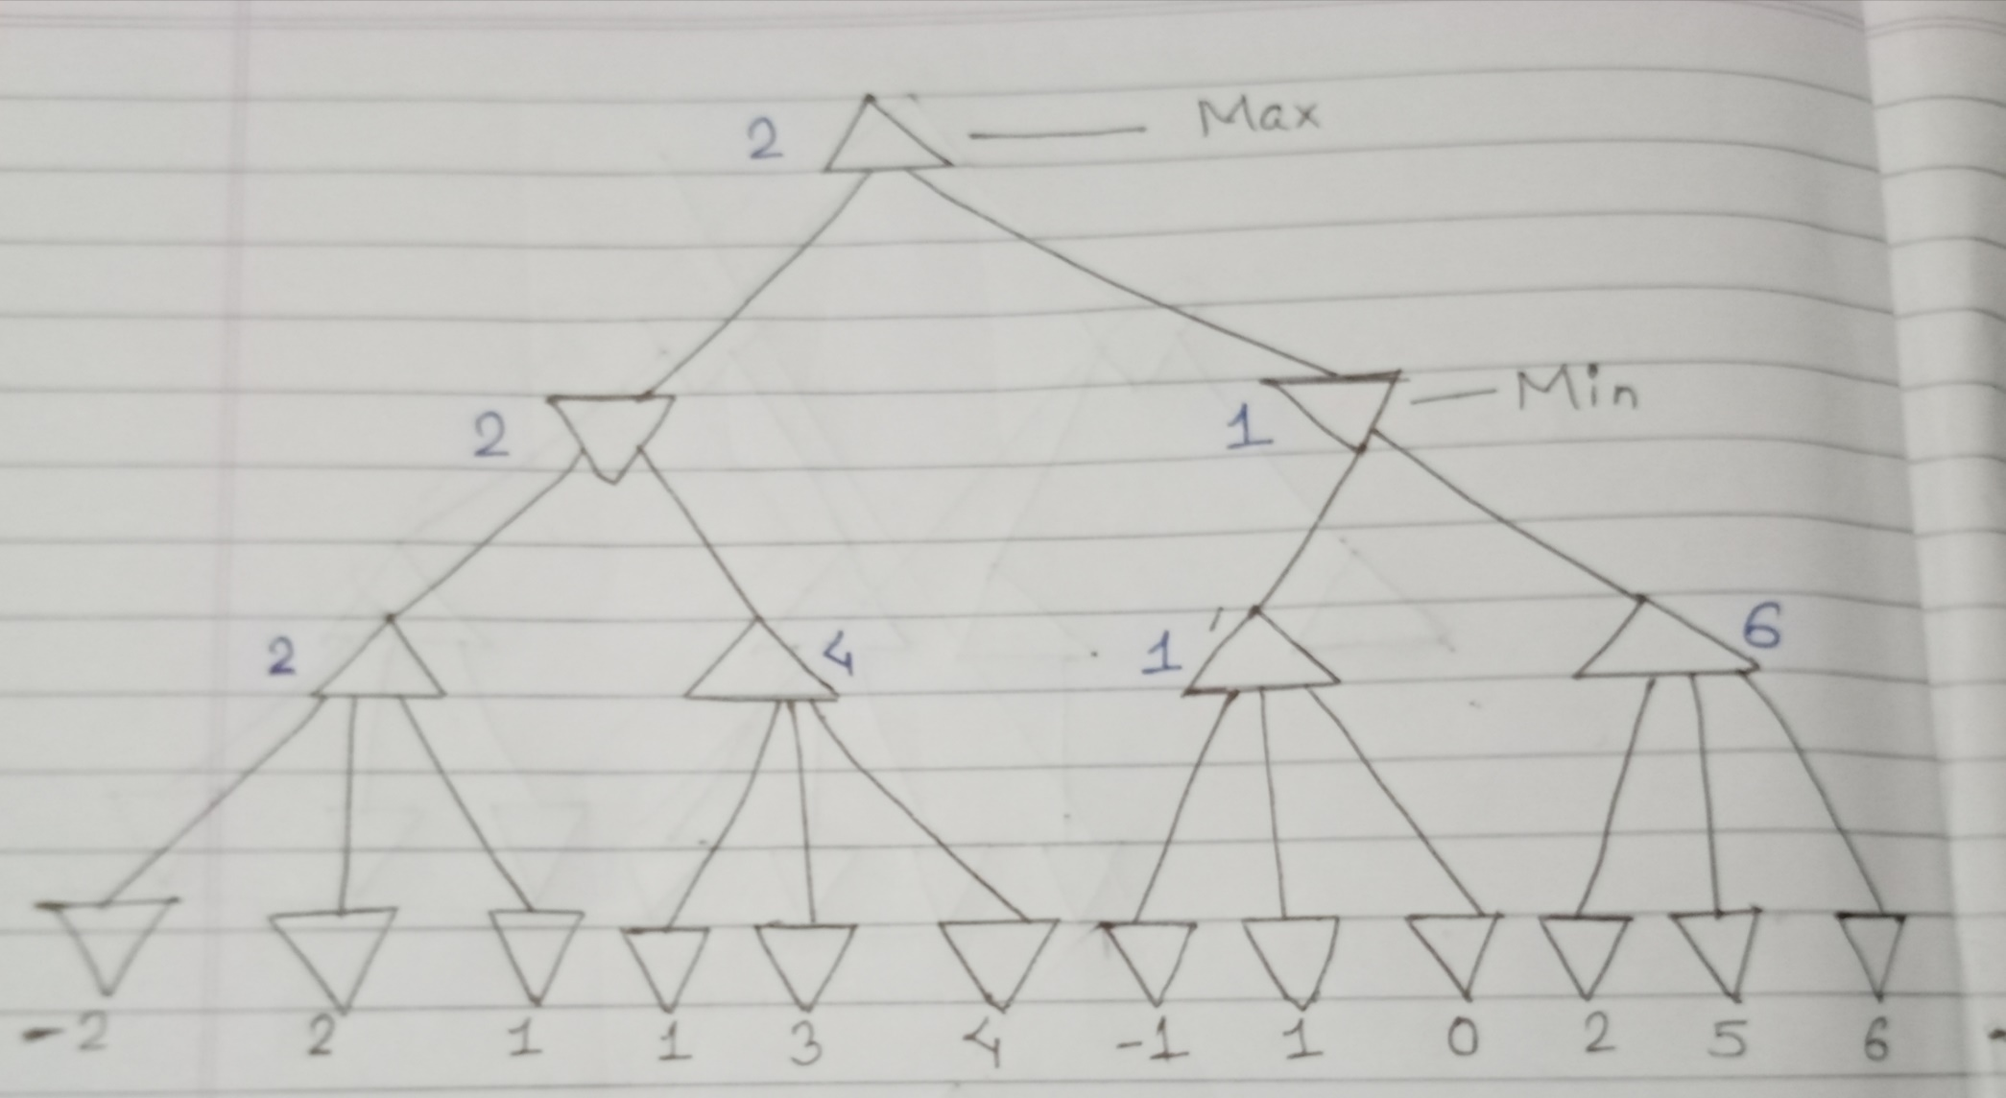
The Minimax Algorithm: Example 1

Slide 72
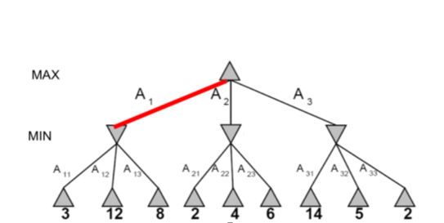
The Minimax Algorithm: Example 2

Slide 73
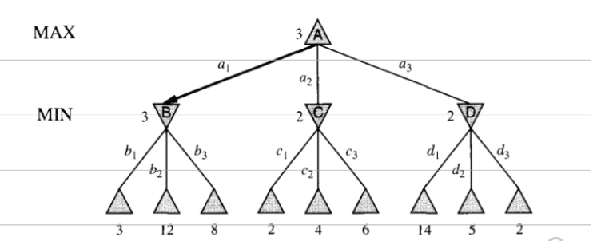
The Minimax Algorithm: Example 2

Slide 74
Minimax Properties
Optimal
Yes, against the perfect player.
Time Complexity?
O(b^{m})
Space Complexity
O(bm)

Slide 75
α-β pruning: General Principle
The problem with minimax search is that the number of game states it has to examine is exponential in the number of moves. Unfortunately, we can not eliminate the exponent, but we can effectively cut it in half. The trick is that it is possible to compute the correct minimax decision without looking at every node in the game tree. That is we can borrow the idea of pruning in order to eliminate the large parts of the tree from consideration. The particular technique we will examine is called α-β pruning. When applied to a standard minimax tree, it returns the same moves as minimax would, but prunes away branches that cannot possibly influence the final decision.

Slide 76
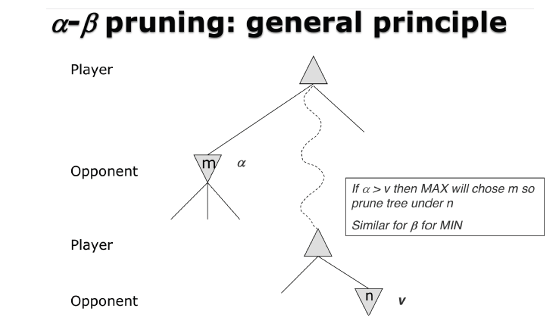

Slide 77
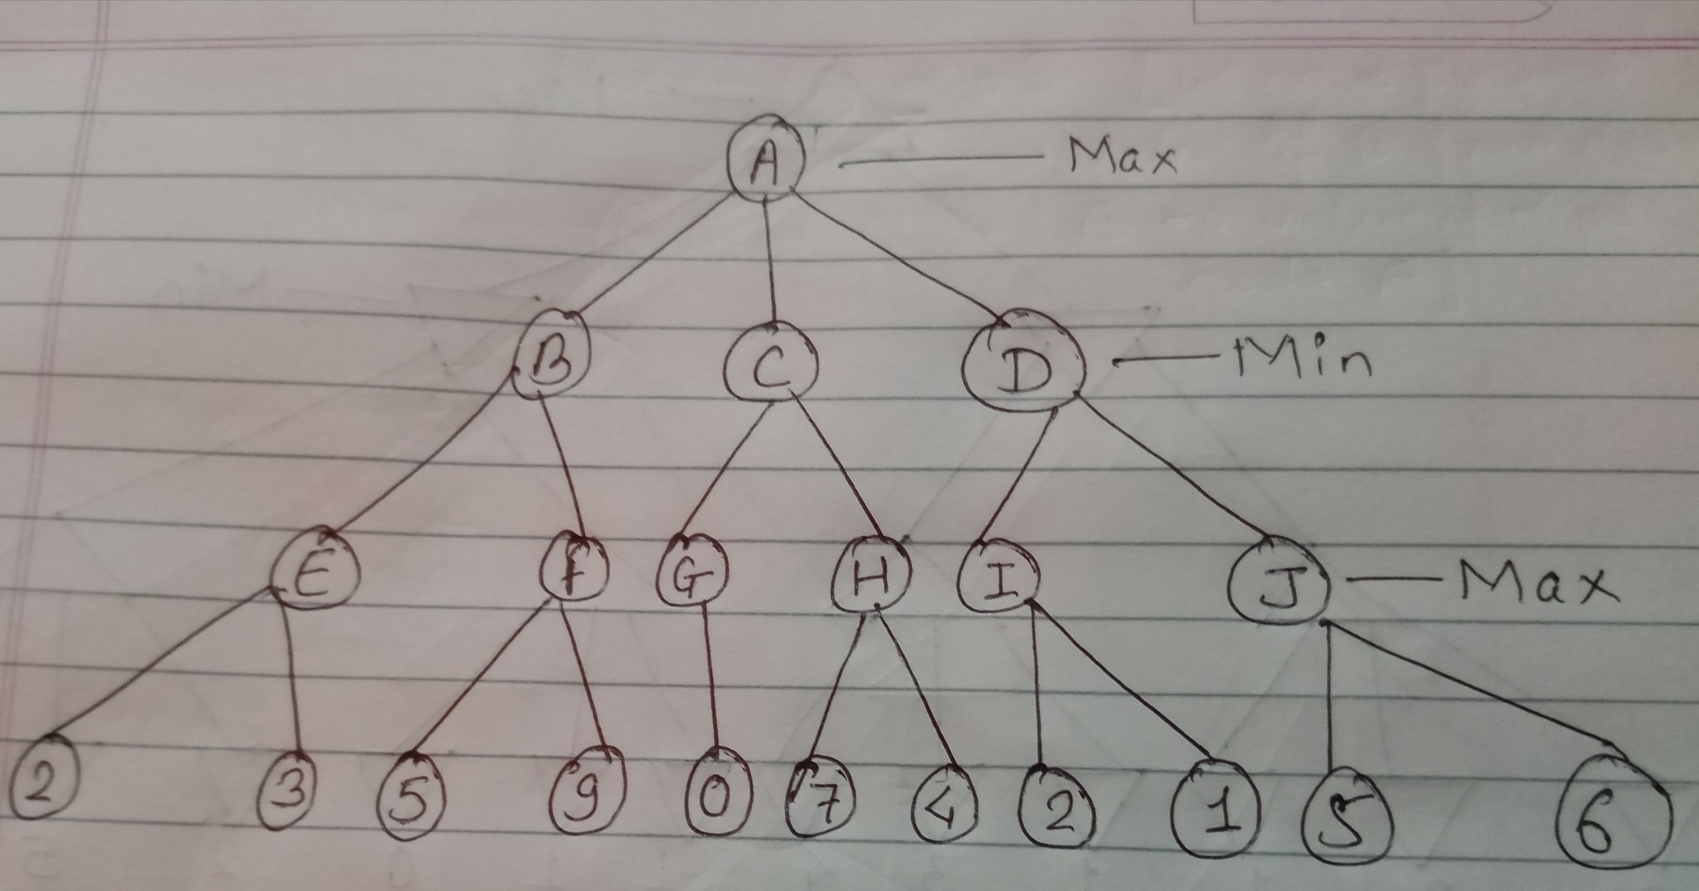
α-β pruning: Example 1

Slide 78
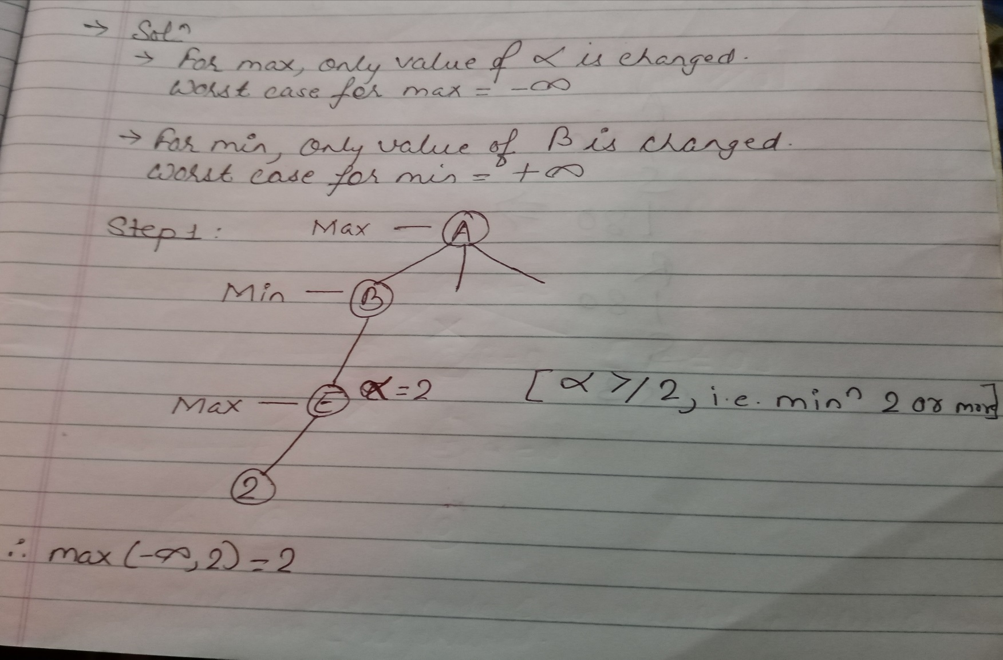
α-β pruning: Example 1

Slide 79
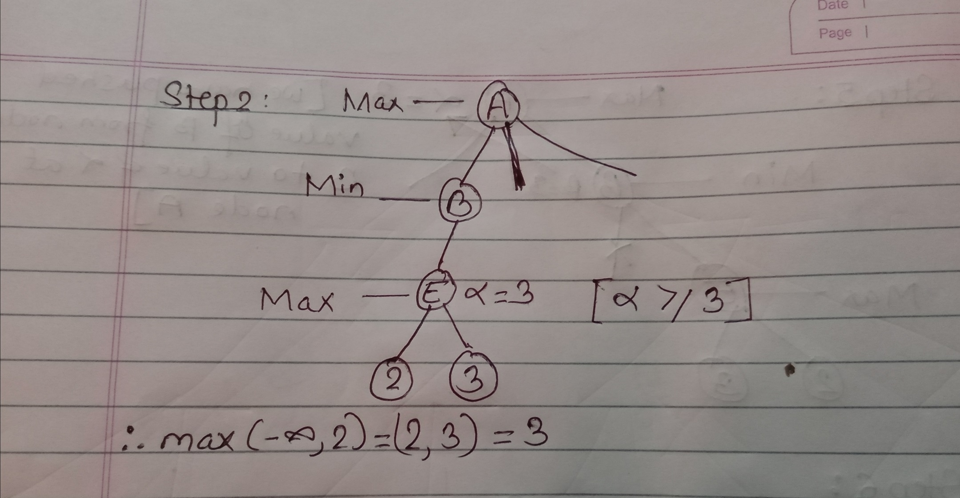
α-β pruning: Example 1

Slide 80
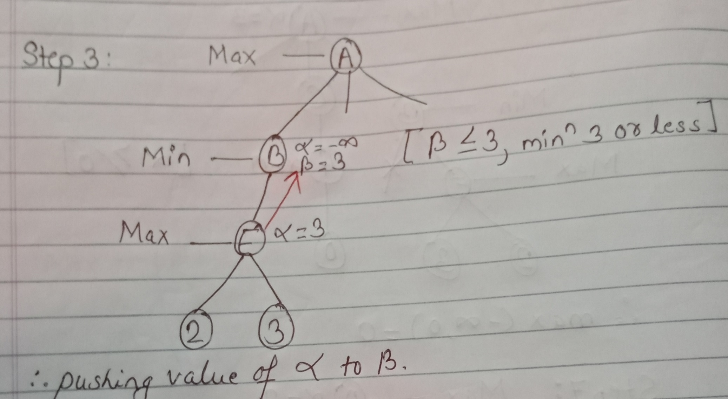
α-β pruning: Example 1

Slide 81
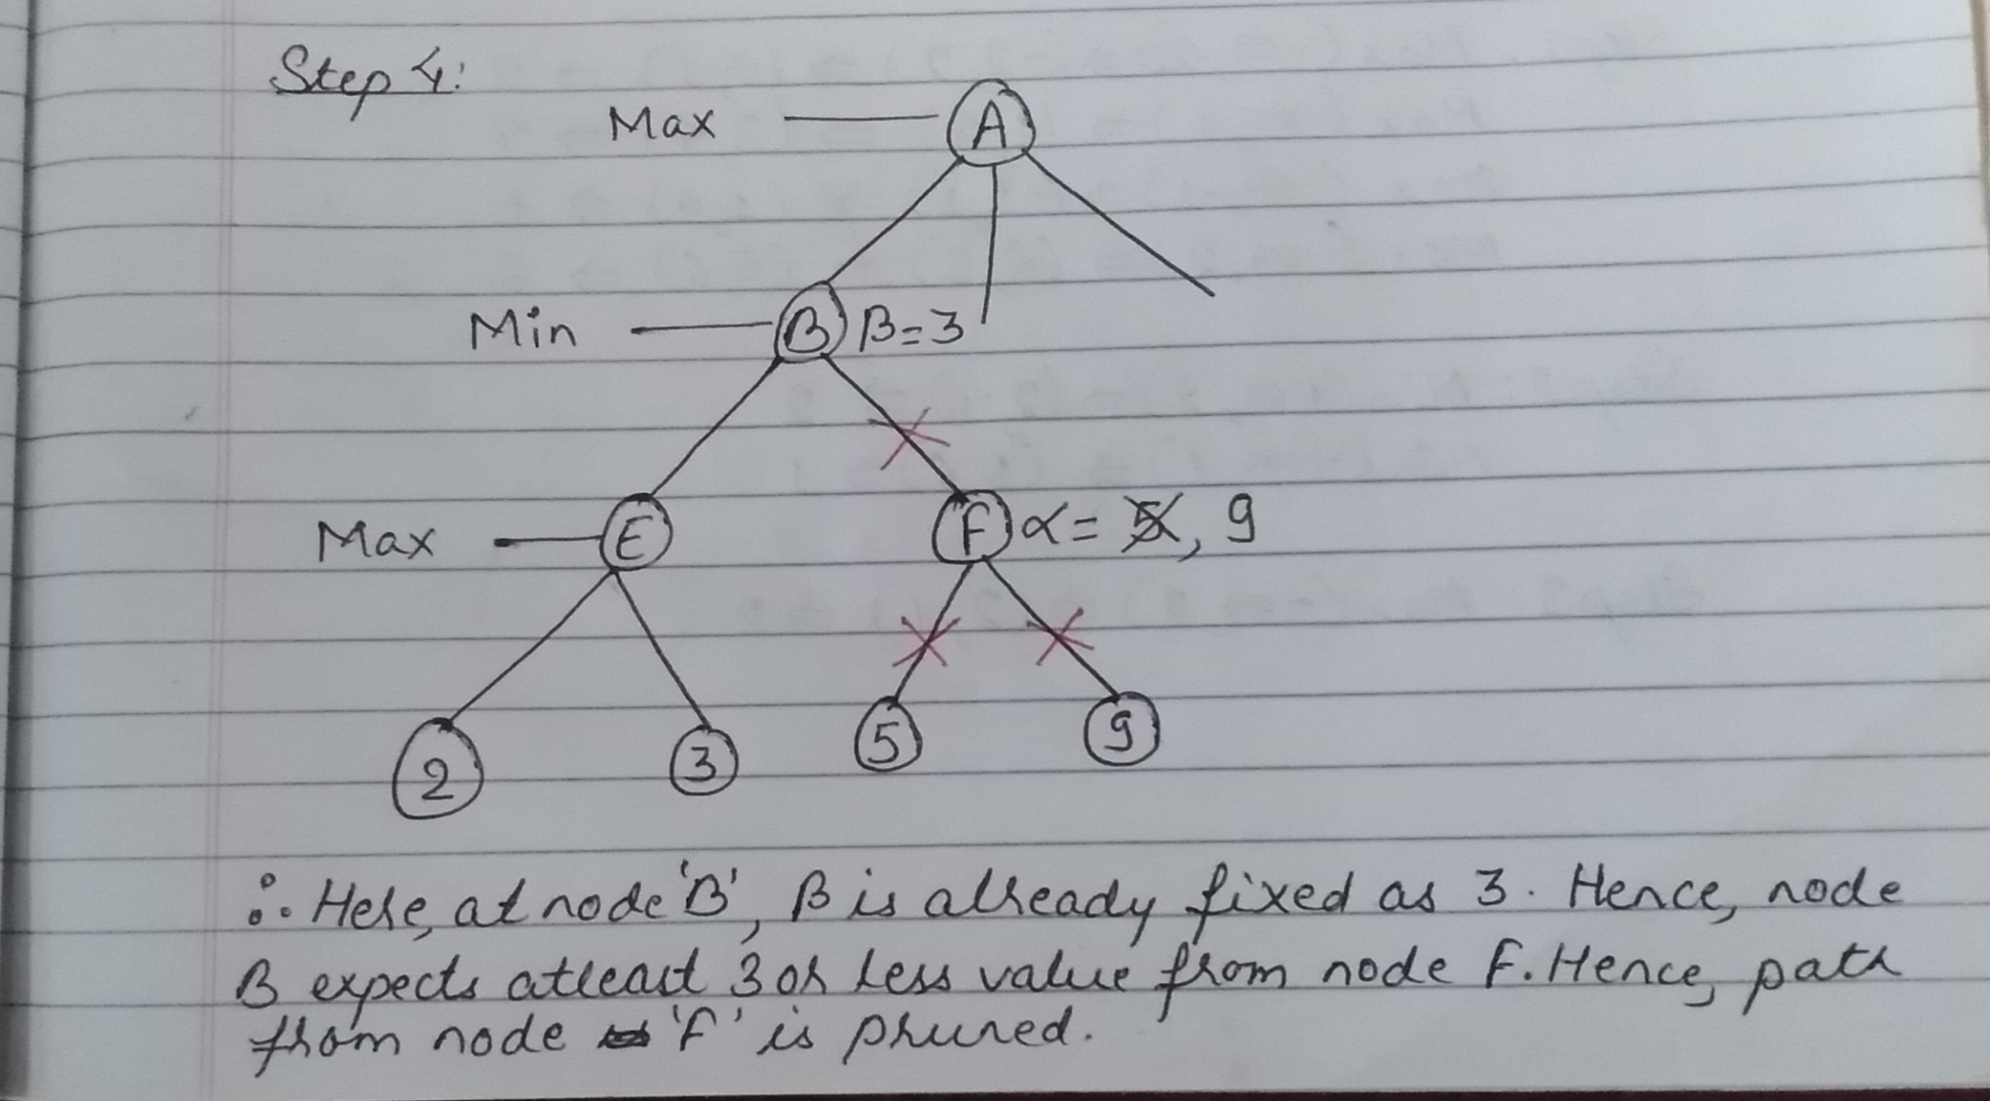
α-β pruning: Example 1

Slide 82
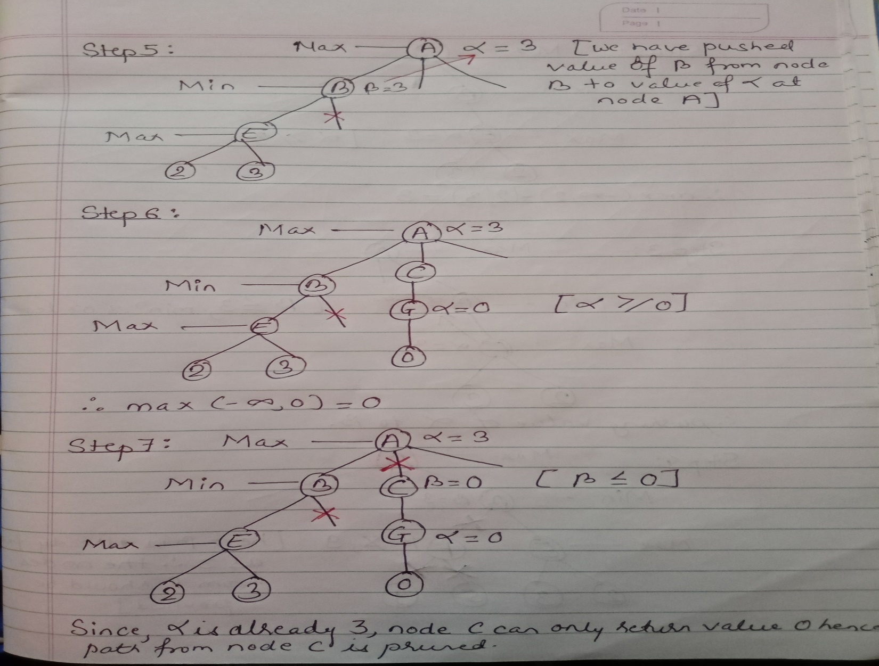
α-β pruning: Example 1

Slide 83
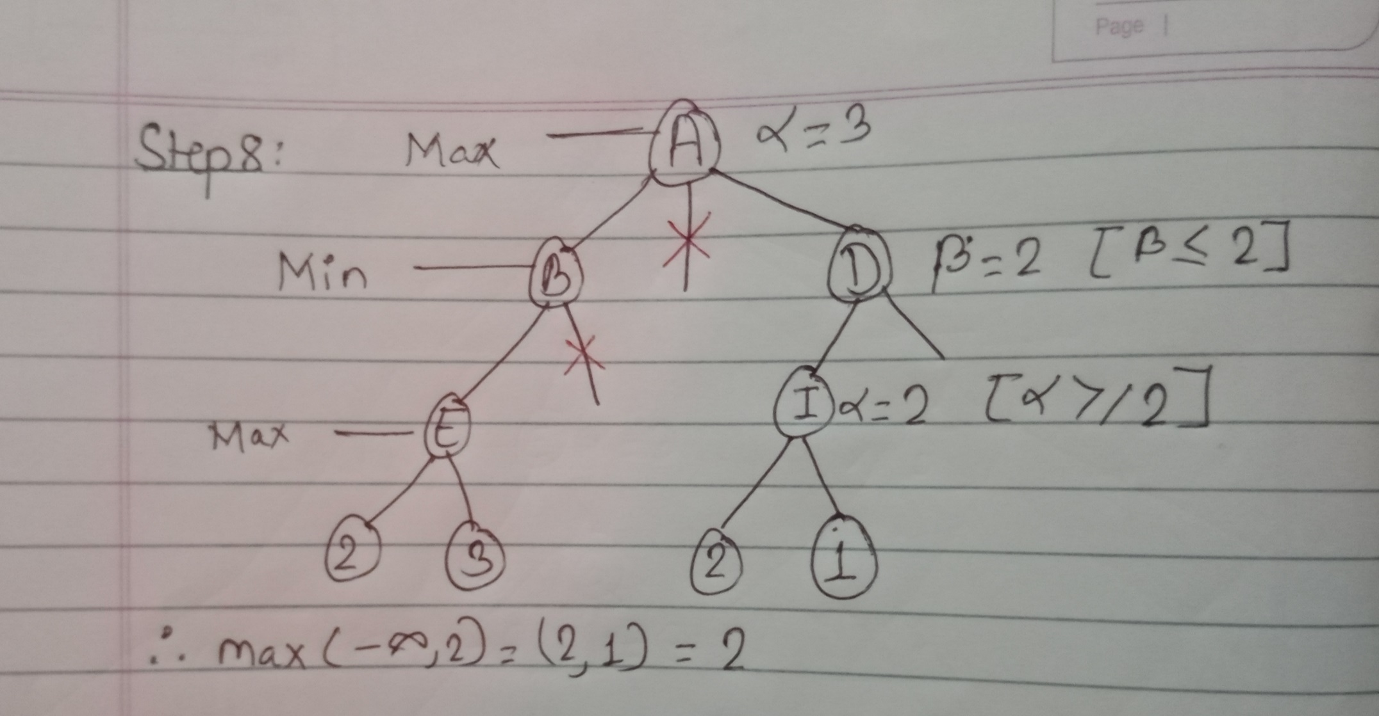
α-β pruning: Example 1

Slide 84
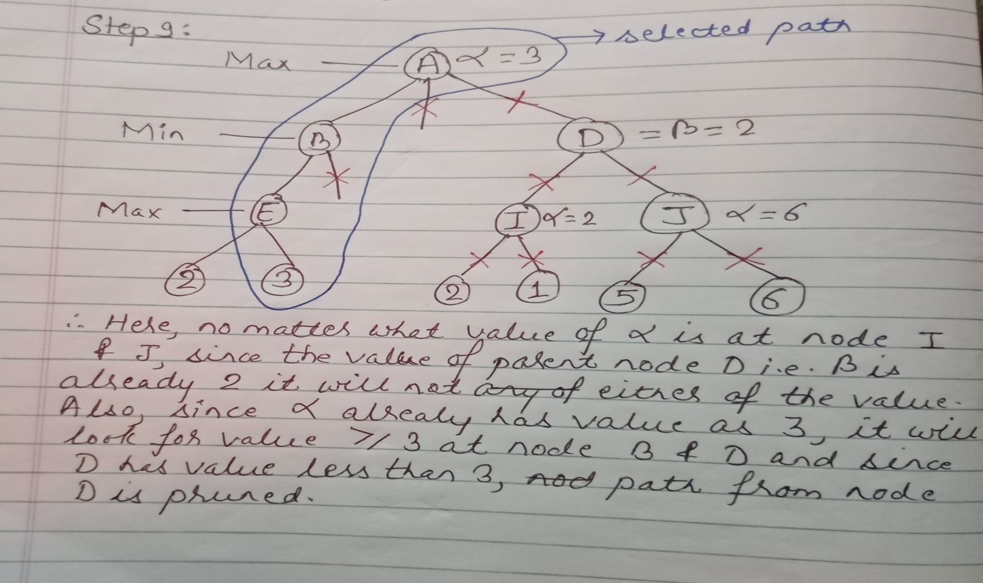
α-β pruning: Example 1

Slide 85
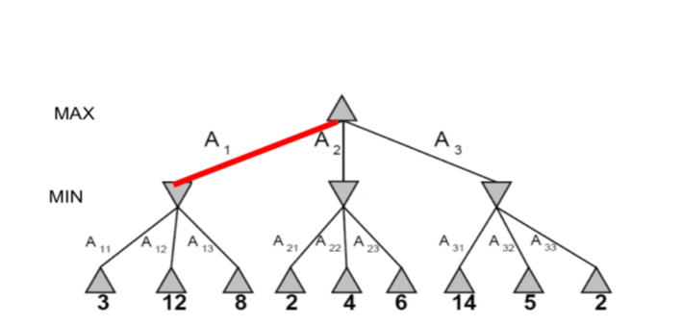
α-β pruning: Example 2

Slide 86
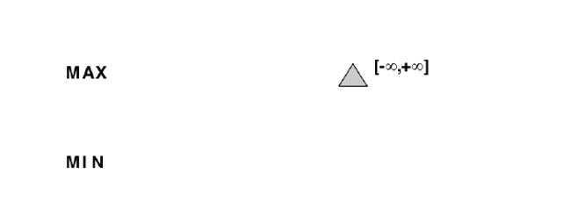
α-β pruning: Example 2

Slide 87
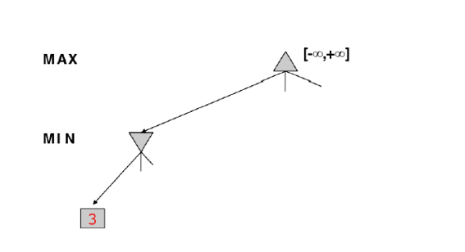
α-β pruning: Example 2

Slide 88
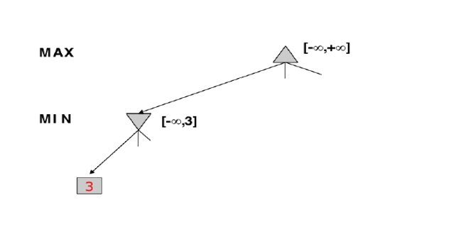
α-β pruning: Example 2

Slide 89
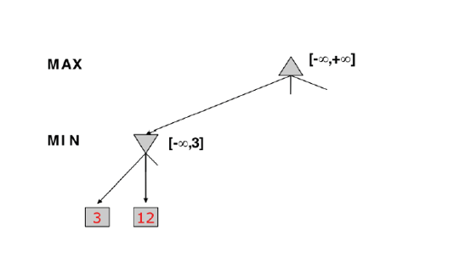
α-β pruning: Example 2

Slide 90

α-β pruning: Example 2

Slide 91

α-β pruning: Example 2

Slide 92

α-β pruning: Example 2

Slide 93

α-β pruning: Example 2

Slide 94

α-β pruning: Example 2

Slide 95

α-β pruning: Example 2

Slide 96
Properties of α-β pruning
Pruning doesn’t affect the final results.
however good move ordering improves the effectiveness of pruning.
With perfect ordering time complexity = O (b^{m/2})

Slide 97
References
E. Rich and Knight, Artificial Intelligence, McGraw Hill, 1991.
D. W. Patterson, Artificial Intelligence and Expert Systems, Prentice Hall, 2001.

